Slide 1
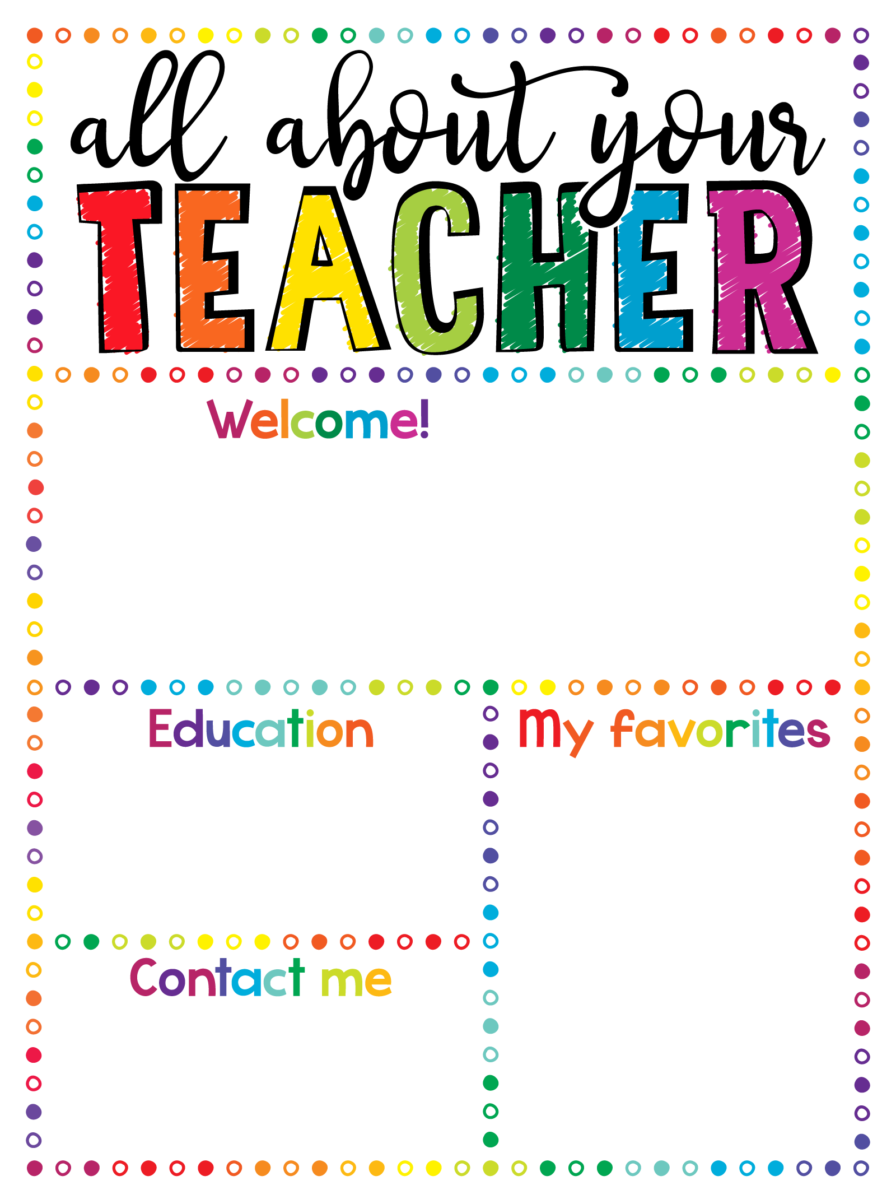
I am thrilled to be in 6th grade! I love teaching math and science almost as much as I love the beach. This is my 29th September at School 30 and I couldn’t be more excited for this school year to begin.
1988 Saunders High School
1993 BS – St. John’s University
1996 MST – IONA College
DRINK: Diet Pepsi
FOOD: Pizza and bagels
STORE: Versona
HOBBIES: Golf
MOVIE: For the Love of the Game
SPORT: Baseball & football
BOOK: Wonder
koconnor@yonkerspublicschools.org

